Slide 1

General Social Media Guidelines and Best Practices for Direct Selling Association Member Organizations
The following guidelines should be a supplement to a corporate set of guidelines provided to your Independent Direct Sellers, including best practices as well as consistency with overall Policies and Procedures for your Company.

Slide 2
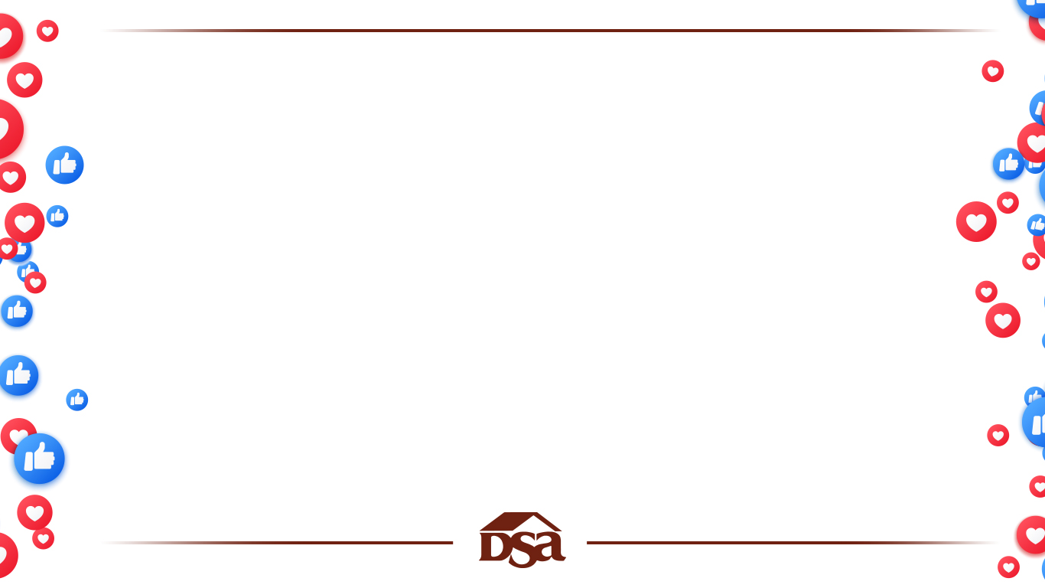







Additionally, all Independent Direct Sellers should be encouraged to familiarize themselves with Community Standards for specific social platforms:
Facebook
Instagram
Pinterest
Twitter
TikTok
LinkedIn
YouTube

Slide 3
Focus on what Independent Direct Sellers can do on social media to empower and motivate them. Provide them with tools and assets to help them build their social media efforts.
Train Independent Direct Sellers on effective personal branding. Encourage them to share their own stories as part of their journey rather than posting products and links which could be seen as spam, potentially leading to social account restrictions or removal.

Slide 4
Determine parameters for naming conventions on social network accounts to ensure Direct Sellers personalization, to avoid being removed for “impersonating a brand.” Provide Direct Sellers with language to include in any Bio, Headline or About section of their profiles. Verbiage should include that the Direct Seller is an “Independent Representative” of the Company.

Slide 5
Educate your Independent Direct Sellers on making income claims.
Information must be completely accurate and not misleading in any way.
All claims must include a disclaimer regarding what a typical earner is likely to achieve or directly link to the company’s online income disclosure statement.
Provide your Independent Direct Sellers with clear examples of what NOT to say or show in an image/video regarding income claims, for example showing off a car or home.
Provide Independent Direct Sellers with clear examples of terms they should NOT use in posts, images or videos. For example: quitting your job, making a million dollars, retiring, buying a home, buying a car , residual income, financial freedom and other claims and terms that are difficult to verify.

Slide 6
Set clear policies for prohibited content as an independent contractor including content that is obscene, profane, hateful, threatening, harmful, libelous, harassing or solicitous of any unlawful behavior.
Provide specific training to Independent Direct Sellers on how to best represent the Company, as well as its products and services with clear examples of utilizing social media formats for promoting their business.

Slide 7
As it relates to your corporate social media accounts, always abide by Independent Direct Sellers Best Practices listed below and lead by example with respect to content targeted to consumers and/or to your sales force.

Slide 8
Independent Direct Sellers Best Practices
Share only photos and videos that you’ve taken or have the right to share.
Foster meaningful and genuine interactions.
Think twice before posting. Privacy does not exist in the world of social media. Posts can be discovered years after they are created. Comments and private messages can be recorded or copied through screenshots and shared later.
Always add value. People produce a lot of spam. Make your post valuable by providing helpful and thought-provoking content. Engage with your followers and cite from others content that helps build on the conversation.
Always be honest about the products and/or services you are selling and your successes. Create a trusting relationship with your audience.

Slide 9
Be respectful. Once you post something, you are inviting a discussion. This can encourage both positive and negative comments. Use tact in your responses, carefully considering how they will reflect on you and the Company.
Be mindful of copyright, trademarks, rights of publicity, and other
third-party rights.
Don’t create accounts that impersonate or misrepresent an affiliation with any person or organization.
Don’t share links to websites that are unsafe, deceptive, untrustworthy, unoriginal, or that facilitate or encourage spam. Websites should have original content that adds unique value for other users.
Be aware of Company Policies and Procedures to be sure you adhere to them and align with the Brand.

